Slide 1
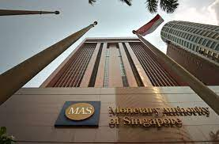
Lecture 2: Financial system, financial markets and instruments
HE Tai-Sen
FINANCIAL ECONOMICS
Notes:
http://news.brown.edu/articles/2017/02/impulse
Suggested readings:
https://scholar.harvard.edu/files/laibson/files/intertemporal_choice.pdf
https://scholar.harvard.edu/files/laibson/files/intertemporal_choice_handbook_vol_2_ericson_laibson.pdf

Slide 2
Financial System, Financial Markets and Instruments
Asset Classes and Financial Instruments
Derivative Markets: Futures and Options (2.5)
What are Futures?
What are Options?
Call option
Put option

Slide 3
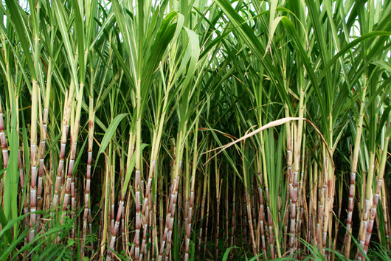
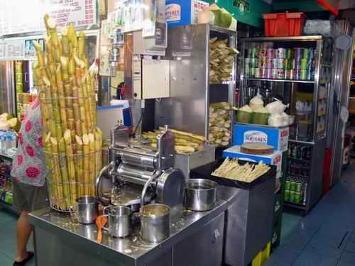
Financial System, Financial Markets and Instruments
Asset Classes and Financial Instruments
Futures Contracts:
Sugarcane farmer vs. Sugarcane stall owner
Notes:
Link: http://2011lphslangfest.files.wordpress.com/2011/03/sugar-cane.jpg

Slide 4
Financial System, Financial Markets and Instruments
Asset Classes and Financial Instruments
A year from now
What can they do to avoid/hedge the risk (profit volatility)?
They can enter into a futures contract:
The long position is held by the trader who commits to purchasing the asset on the delivery date. (stall owner)
The trader who takes the short position commits to delivering the asset at contract maturity. (farmer)
Price of sugarcane | Sugarcane farmer’s profit | Sugarcane stall owner’s profit
80 | 0 | 500
100 | 250 | 250
120 | 500 | 0

Slide 5
Financial System, Financial Markets and Instruments
Asset Classes and Financial Instruments
Definitions of Futures Contracts:
Investopedia Definition: A futures contract is a financial contract obligating the buyer to purchase an asset (or the seller to sell an asset), such as a physical commodity or a financial instrument, at a predetermined future date and price.
Textbook Definition: A futures contract calls for delivery of an asset at a specified delivery or maturity date for an agreed-upon price, called the futures price, to be paid at contract maturity.

Slide 6
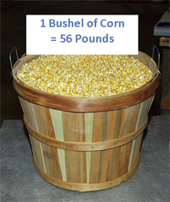
Financial System, Financial Markets and Instruments
Asset Classes and Financial Instruments
Futures Contracts example:
Corn futures prices listing
Month | Last | Chg | Open | High | Low | Volume
Mar 2024 | 371’2 | -1’6 | 372’4 | 377’6 | 368’6 | 53150
One contract=5000 bushels of corns
Price per bushel: 371’2 cents=371.25 cents=$3.7125 per bushel
(the numbers after the apostrophe denote eighths of a cent ‘1=1/8 cent)

Slide 7
Financial System, Financial Markets and Instruments
Asset Classes and Financial Instruments
Options:
A call option gives its holder the right to purchase an asset for a specified price, called the exercise or strike price, on or before a specified expiration date. (farmer could be the writer)
A put option gives it holder the right to sell an asset for a specified exercise price on or before a specified expiration date. (stall owner could be the writer)
European options can be exercised only on the expiration date whereas American options can be exercised on or before the expiration date.

Slide 8
Financial System, Financial Markets and Instruments
Asset Classes and Financial Instruments
How do call options work?
Suppose that you would like to purchase a share of IBM stock next year (trading at $95 per share now). But, you are concerned that the price will be too high. Thus, you pay $3 premium to purchase a call option with exercise price $100.
The value at expiration of the call with exercise price $100 is:
Profit=Option Value - Premium
Stock price on expiration | $90 | $100 | $110 | $120 | $130
Option Value on expiration | 0 | 0 | 10 | 20 | 30

Slide 9
Financial System, Financial Markets and Instruments
Asset Classes and Financial Instruments
How do put options work?
Suppose that you own a share of IBM stock (trading at $95 per share now) and plan on selling it next year. But, you are concerned that the price will be too low. Thus, you pay $3 premium to purchase a put option with exercise price $100.
The value at expiration of the put with exercise price $100 is:
Profit=Option Value - Premium
Stock price on expiration | $90 | $100 | $110 | $120 | $130
Option Value on expiration | 10 | 0 | 0 | 0 | 0

Slide 10
Financial System, Financial Markets and Instruments
Asset Classes and Financial Instruments
Comparison between Futures and Options:
A long position in a futures contract obligates the holder to purchase the underlying asset at the agreed-upon futures price.
A call option grants the holder the right, but not the obligation, to purchase the asset at the exercise price. The purchase occurs only if it results in a profit. This flexibility comes at a cost—the price paid for the option, known as the premium.

Slide 11
Financial System, Financial Markets and Instruments
Asset Classes and Financial Instruments
Example: Trading data on Intel options
Prices at close, 6 Feb, 2025 Underlying stock price: 20.83
Try to make sense of the following statements:
Option prices (i.e., premiums) cannot be less than zero.
For call options, higher strike prices leads to lower premiums.
For put options, higher strike prices leads to higher premiums.
Expiration | Strike | Call |  | Put
 |  | Last | Volume | Last | Volume
Mar 2025 | 20.00 | 0.84 | 36929 | 0.03 | 8897
Apr 2025 | 20.00 | 1.21 | 11715 | 0.52 | 7979
Mar 2025 | 21.00 | 0.17 | 77484 | 0.33 | 21907
Apr 2025 | 21.00 | 0.64 | 23848 | 0.94 | 6407

